Slide 1

World Health Statistics 2023: Global Health Insights
Analyzing key health indicators across regions to understand global health disparities and identify opportunities for improvement.
Data Source: WHO Database/ Global Health Observatory
https://www.who.int/data/gho/publications/world-health-statistics
by _ Kariithi Anne |Mercy Chebet |Maureen Jemutai

Slide 2

Introduction to Global Health Statistics 2023
1
Comprehensive Data
The World Health Statistics 2023 report provides a comprehensive overview of key global health indicators, including maternal and child mortality, life expectancy, healthcare workforce density, and communicable diseases.
2
Unequal Outcomes
Investigate differences in healthcare access and quality across regions, prompting further analysis.
3
Driving Insights
Visualizing disparities to understand underlying causes and identify potential improvements.

Slide 3
Understanding the Problem
1
Healthcare Access
4
Economic Factors
To analyze the distribution of healthcare workforce and resources across the region per country.
To explore how infrastructure differences affect healthcare services, i.e., universal health coverage and health aid per region.
2
Mortality Rates
5
Adolescent birth rate trends
To investigate maternal and child mortality rates across regions and ways to mitigate them.
To evaluate the trends in adolescent births and ways to mitigate early pregnancies in teen girls.
3
Disease Exposure
To investigate the risk of communicable diseases across regions. This includes malaria, TB, and HIV incidences.

Slide 4
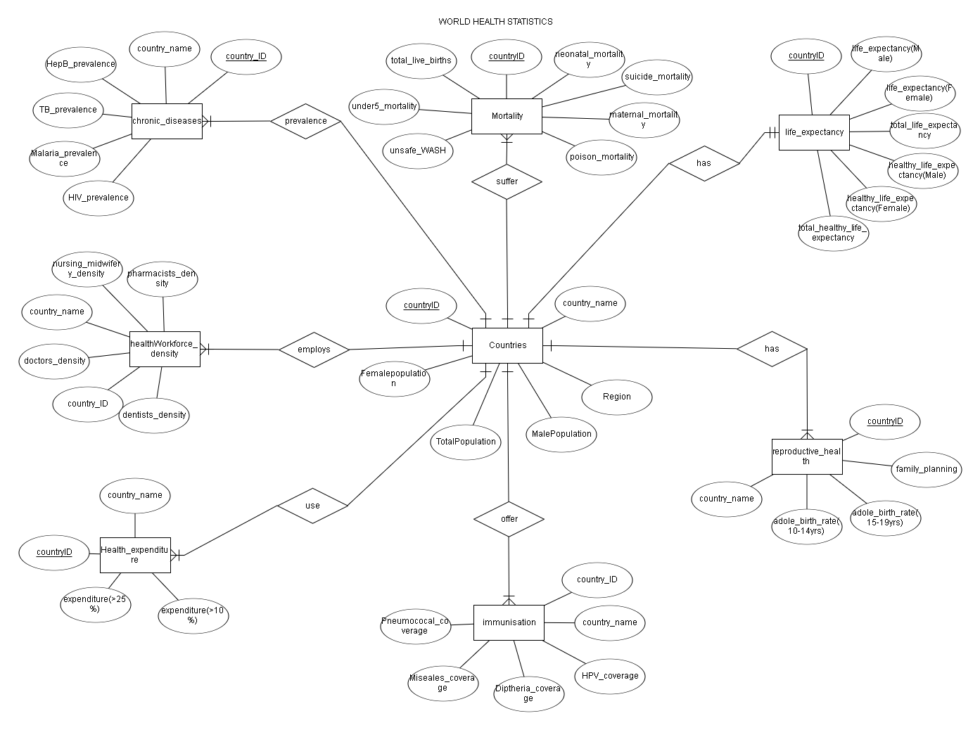
Database Entity Relationship Diagram
1
ER Diagram
The indicators were decomposed to inform the health database created, the ER diagram below tells more about its structure:

Slide 5
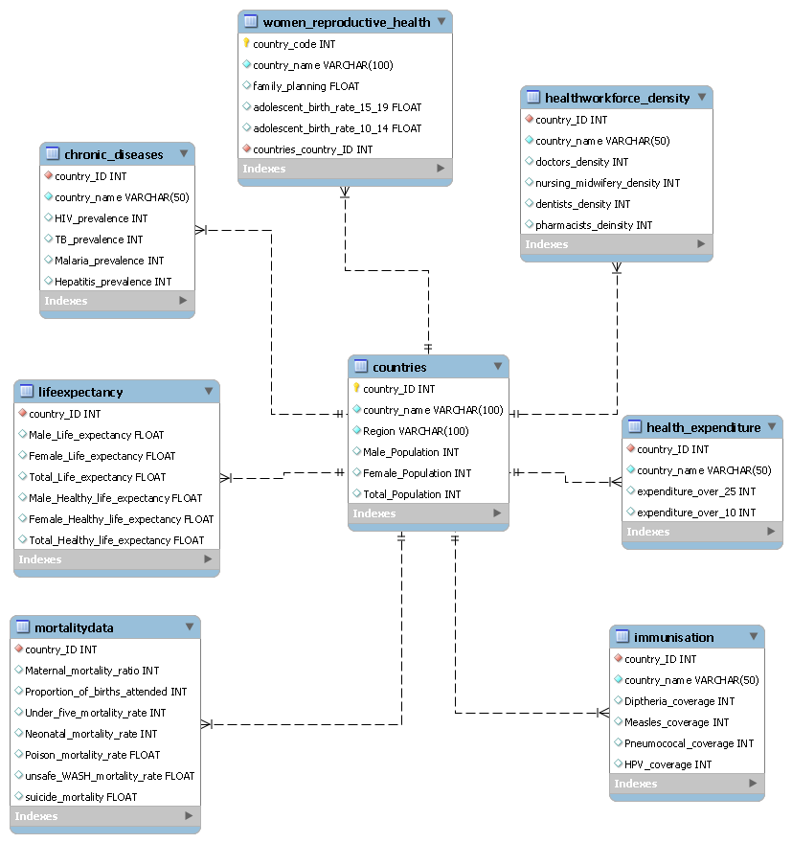




Database Schema
1
Key Indicators
2
Database Schema
The 2023 report reviewed more than 50 health indicators from the SDG. We focused our work on the following 6 indicators:
The indicators were decomposed to inform the health database created, the schema shows the physical database representation:
KEY HEALTH INDICATORS
Maternal Mortality
Neonatal Mortality
Under-5 Mortality
Life and Healthy Life Expectancy
Health Workforce
Universal Health Coverage

Slide 6
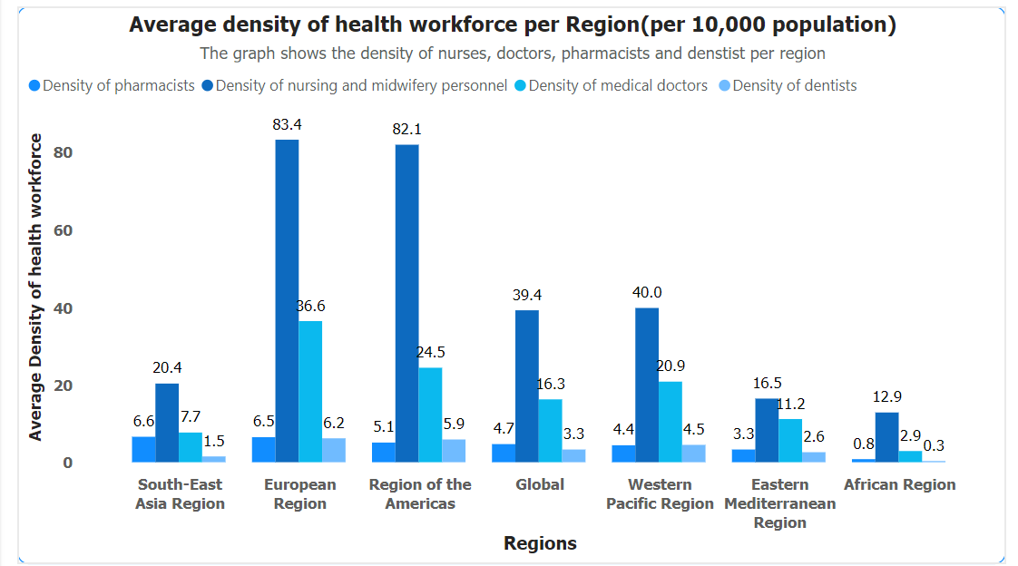
Key Findings - Health Workforce distribution across WHO regions
The African Region has the lowest density across all categories of healthcare workers.
Many African and Southeast Asian countries fall below the WHO's recommended health worker density of 4.45 per 1000 population.

Slide 7
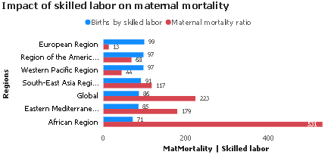
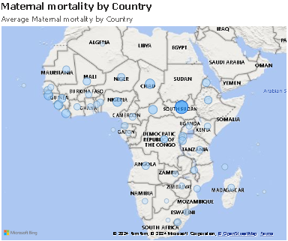
Key Findings - Impact of skilled labour on maternal mortality
Maternal mortality tends to be more severe in Central, West, and East Africa, with Southern Africa exhibiting better healthcare outcomes for maternal health.
Africa has the highest maternal mortality ratio, largely due to inadequate access to skilled birth attendants, low healthcare workforce density, and poor healthcare infrastructure.

Slide 8
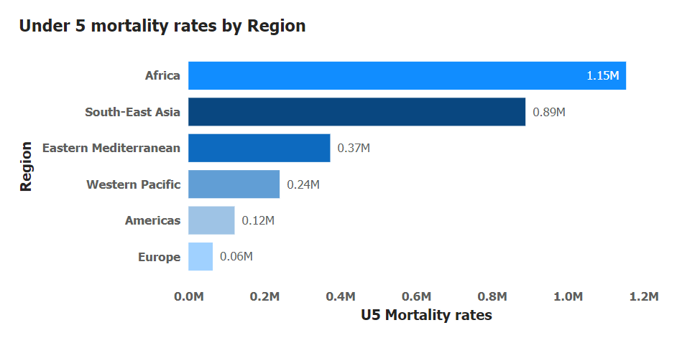
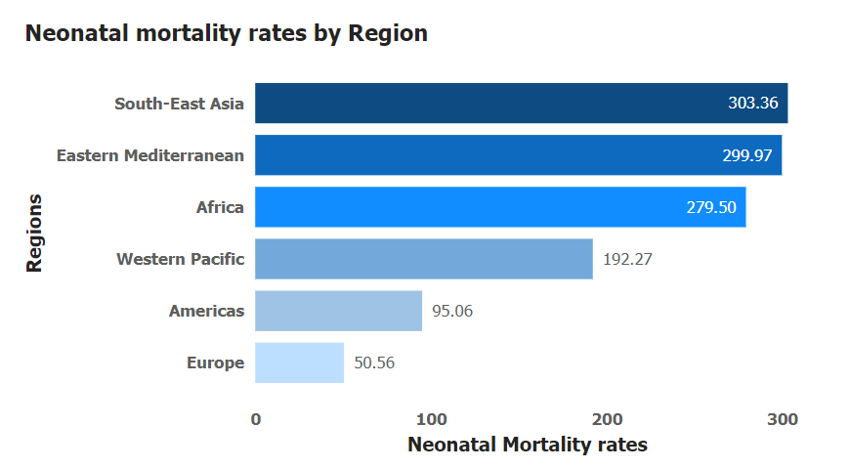
Key Findings – Child mortality rates per Region
Africa and South-East Asia are the regions most affected by high under-five and neonatal mortality rates, reflecting critical health challenges. They account for 80% of under-five deaths, due to poor access to skilled birth attendants and inadequate prenatal and neonatal care in rural or underserved areas
Europe has the lowest child mortality rates, indicating more robust healthcare systems and better healthcare access for children.

Slide 9
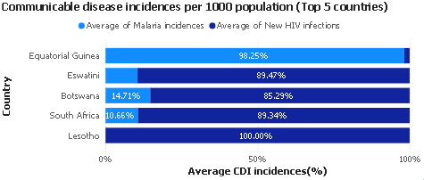
Key Findings – Communicable disease burden per Region
Among the top 5 countries affected by communicable incidences, new HIV infections are more prevalent in comparison to Malaria.
Lesotho stood out as a malaria-free zone in our analysis (declared by WHO in 2012) while Equatorial Guinea had the highest malaria prevalence.

Slide 10
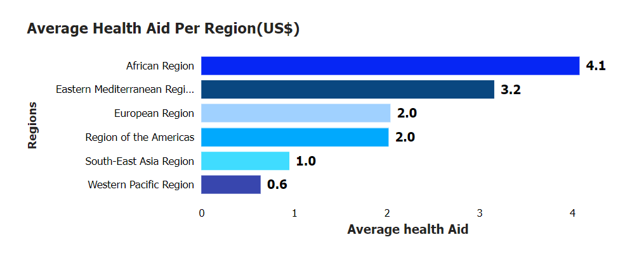
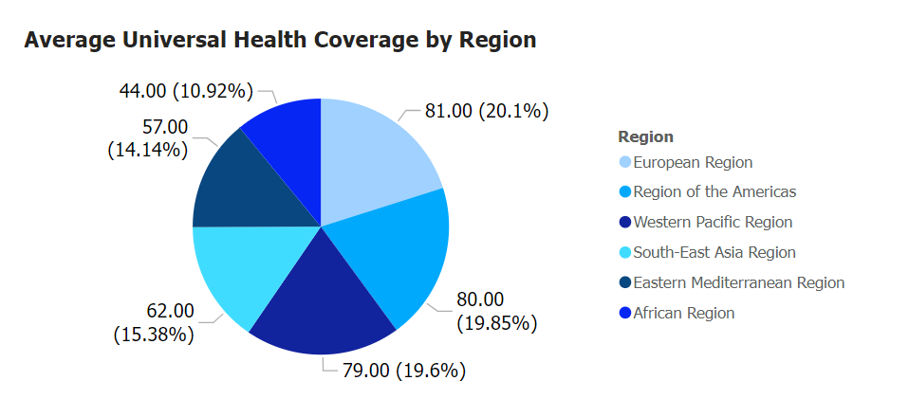
Key Findings – Comparison between Health Aid and health coverage
The African and Eastern Mediterranean Regions receive the most funding from WHO but have the lowest universal health coverage recorded at 10.92% of the global coverage.
Africa receives significant international health aid, often targeted at communicable diseases, maternal and child health, and immunization campaigns. However, this aid may not address long-term, systemic improvements in healthcare infrastructure and universal healthcare systems.

Slide 11
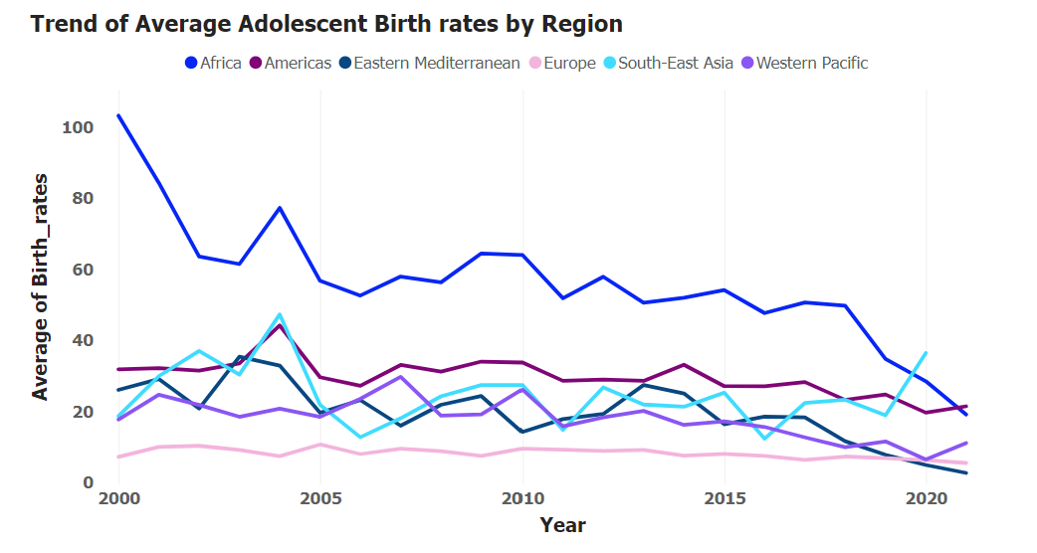
Key Findings – Trends in adolescent births per region
While adolescent birth rates have declined globally, they have remained generally stagnant or even increased in Southeast Asia. This is attributed to the high prevalence rates of child marriage and early union according to WHO.
According to UNICEF, nearly 40% of girls in Sub-Saharan Africa are married before the age of 18, leading to early childbearing. Cultural practices, poverty, lack of education, and poor maternal healthcare for adolescents influence this.

Slide 12
Reasons for Regional Health Disparities
A Case for the African Region
Adolescent Births in Africa
1
Africa, particularly Sub-Saharan Africa, has one of the highest rates of adolescent births for girls aged 10-14 globally, driven by factors like cultural norms, poverty, and lack of access to healthcare.
2
Healthcare Workforce Density
The healthcare workforce density (doctors, nurses per capita) is much lower in the African region, contributing to its low UHC. Even with substantial health aid, countries with insufficient healthcare personnel cannot provide universal health services, leading to gaps in healthcare access.
Low Universal Health Coverage in Africa
3
Despite high levels of external health aid, the African region has the lowest UHC index globally, as health aid is often targeted and short-term. In contrast, many African countries have underfunded national health systems.

Slide 13

Visualization Summary
Decline in Early Marriage
Child mortality Rates
Health aid vs Universal health coverage (UHC)
The proportion of African girls married before age 18 has declined from 42% to 34% over the past decade, showing that efforts to end child marriage are having a positive effect on adolescent birth rates.
While neonatal deaths are a concern, Africa’s under-five mortality is compounded by low immunization coverage. WHO data shows that millions of children in Africa miss routine immunizations due to logistical barriers
The relationship between health aid and UHC highlights a critical issue: while aid provides temporary relief for targeted issues, such as infectious disease outbreaks, it does not replace the need for comprehensive, systemic healthcare reforms to achieve UHC

Slide 14



Opportunities for Further Analysis
Digital Health Platforms
Focus on NCDs
Strengthen Immunization
Improve data collection and tracking in low-resource settings.
Expand focus on non-communicable diseases in emerging health threats.
Scale up immunization programs in regions with low coverage.

Slide 15

Next Steps
1
Health aid utilization
Further analysis on the spending of the allocated health aid across WHO regions to explore the effectiveness of these funds in strengthening healthcare systems particularly in regions with low health universal coverage.
2
Health workforce Imbalance
Investigate the disparities in health workforce distribution across regions, paying attention to the growing trend of international migration of healthcare workers to get factors driving this migration and its implication on the standard of health in a region
3
Low immunization coverage
A deeper analysis of the reasons for low immunization coverage in the African region, factors that might be driving this, and ways to improve immunization coverage as well as its receptiveness among natives.

Slide 16

Thank You
For your Attention

